Slide 1
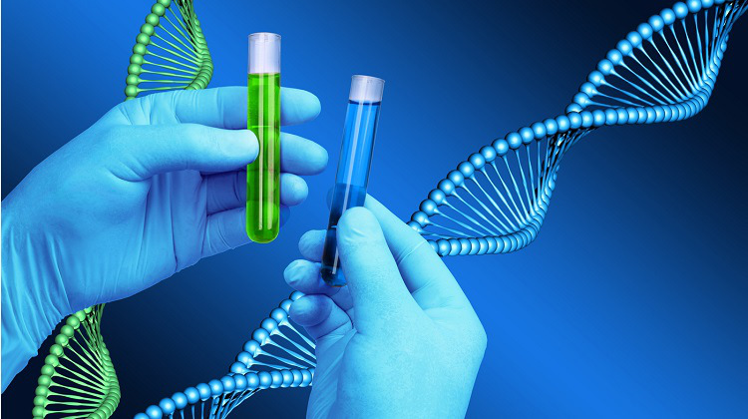
DNA Profiling In Forensic Science

Slide 2
Presenters : Supan Roy ID: 232-15-716 Md Yeasin Shazad Peal ID: 232-15-102
Presenting To:
Mr. Tanim Ahmed
Lecturer , Department of CSE
Daffodil International University

Slide 3
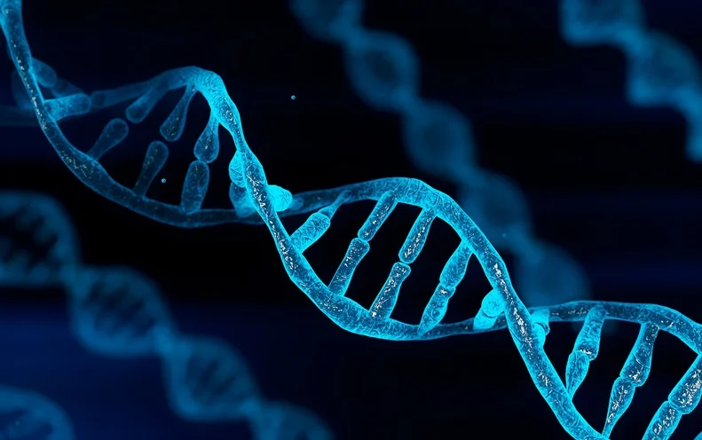
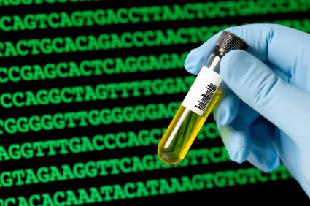
Introduction
DNA is present in most of the cells in our body, which is unique in each and every individual, and we leave a trail of it everywhere we go. This has become an advantage for forensic investigators who use DNA to draw conclusion in identification of victim and accused in crime scenes. This review described the use of genetic markers in forensic investigation and their limitations.

Slide 4
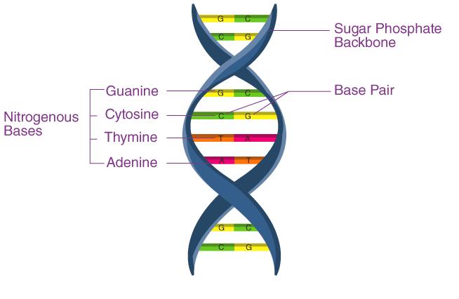
DNA Structure and Genome
DNA is often described as the “Blue Print of Life” because it contains all the information that an organism requires in function and reproduction. The DNA molecule is a Polymer of Nucleotides. Each nucleotide is composed of a nitrogenous base, a five-carbon sugar (deoxyribose), and a phosphate group. There are four Nitrogenous bases in DNA, two Purines (Adenine and Guanine) and two Pyrimidines (Cytosine and Thymine).
Structure of a DNA

Slide 5
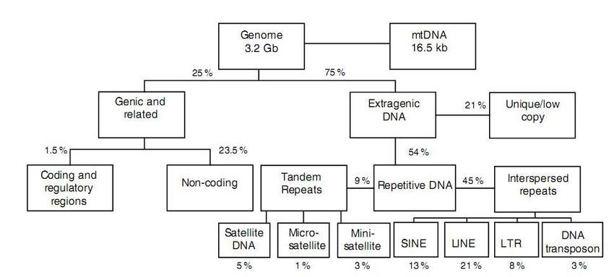
Classification of Human Genome
Based on the structure and function, Classification of Human Genome into following different types:
Coding and regulatory regions (1.5%)
Noncoding (23.5%)
Extragenic DNA (75%)
Classification of human genome DNA based on its structure and function

Slide 6
Genome and Forensic Genetics
DNA loci that are to be used for forensic genetics should have the following ideal properties:
• Should be highly polymorphic.
• Should be easy and cheap to characterize.
• Should be simple to interpret and easy to compare between laboratories.
• Should have a low mutation rate.

Slide 7
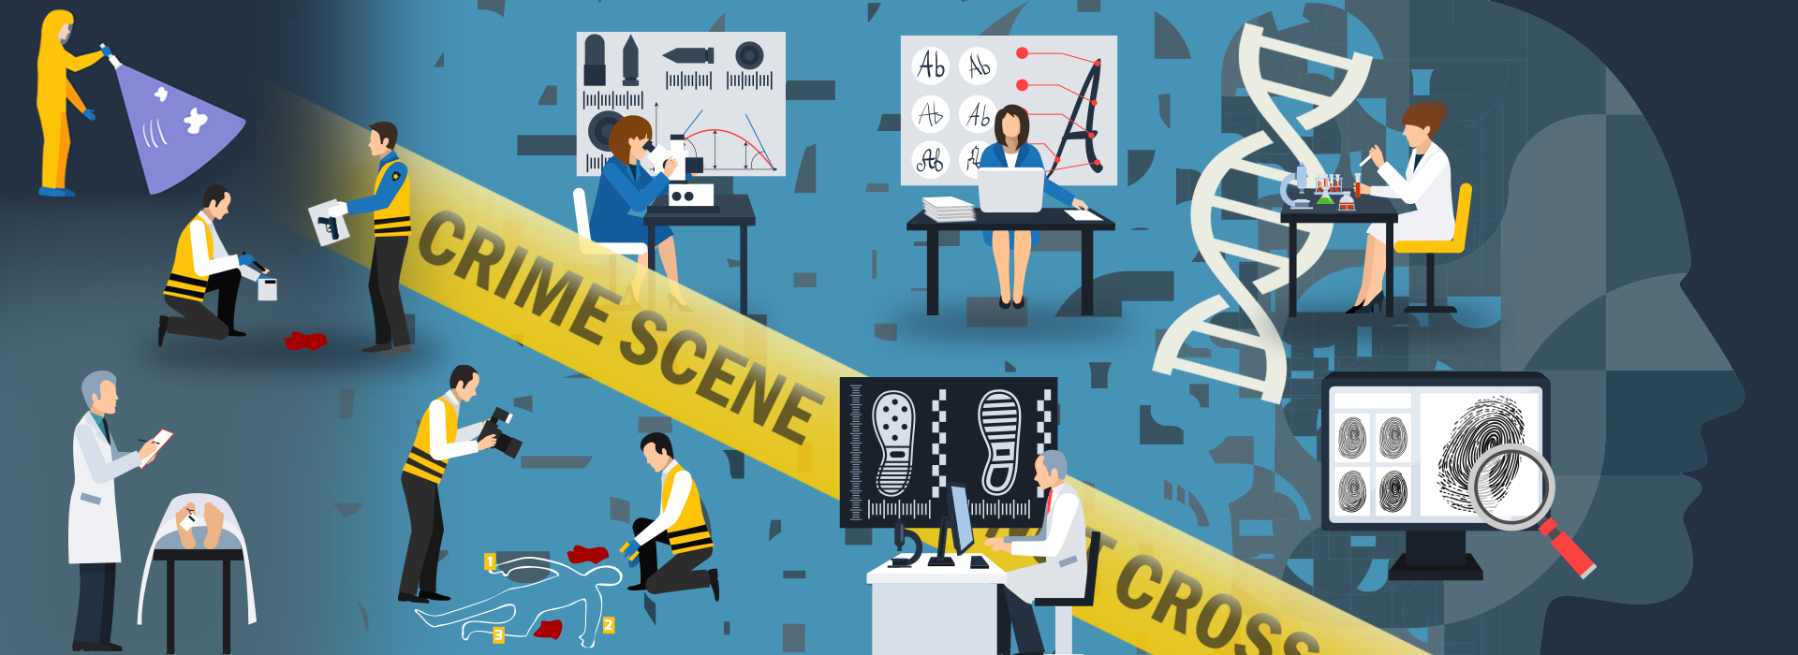
Collection and Handling of Material at the Crime Scenes
The following evidences can be found at the Crime Scene:
• Liquid blood or dry deposits.
• Liquid saliva, semen, or dry deposits.
• Hard tissues like bone and teeth.
• Hair with follicles.

Slide 8

Characterization of DNA Analysis: Basic Steps
Analysis of DNA involves four basic steps, which are as follows:
1.DNA Extraction.
2. DNA Quantification.
3. DNA Amplification.
4. Detection of the DNA-amplified products.

Slide 9
DNA Extraction
There are various methods of extraction as mentioned below:
1. Chromatography-based DNA extraction method.
2. Ethidium bromide–cesium chloride (EtBr-CsCl) gradient
centrifugation method.
3. Alkaline extraction method.
4. Silica matrices method.
5. Salting-out method.
6. Cetyltrimethylammonium bromide (CTAB) extraction
method.
7. Phenol–chloroform method.
8. Sodium dodecyl sulfate (SDS)-proteinase K method.
9. Silica column-based DNA extraction method.
10. Magnetic beads method.
11. Cellulose-based paper method.
12. Chelex-100 extraction method.
13. Filter paper-based DNA extraction method.

Slide 10
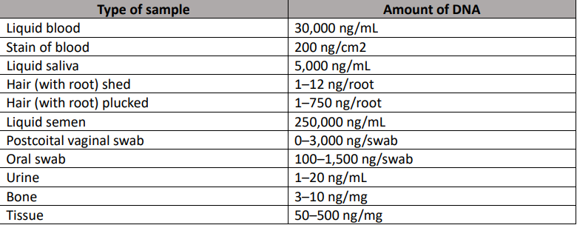
DNA Quantification
After DNA extraction, an accurate measurement of the amount and quality of DNA extract is desirable.
Quantity of DNA that can be extracted from a sample
depends on the type of model. Quantity of DNA in different
biological samples is shown in the Table.

Slide 11
DNA Amplification
There are eight DNA- and RNA-based techniques, but PCR
and reverse transcription-PCR have been the predominant techniques.
DNA amplification occurs in cycling phase, which
consists of three stages:
1. Denaturation.
2. Annealing.
3. Extraction.

Slide 12
Detection of the DNA-Amplified Products
The following methods are used in forensic human
identification:
1. Autosomal short-tandem repeat (STR) profiling
2. Analysis of the Y chromosome
3. Analysis of mt-DNA.
4. Autosomal single-nucleotide polymorphism (SNP) typing.

Slide 13
Analysis of the Y Chromosome
Typically, biologically a male individual has 1 Y chromosome and contains 70-200 genes.
Because of this unique feature, analysis of Y chromosome is done in crime cases.
Application of Y chromosome in forensic medicine:
It is present only in males. Thus, in crime cases, the investigators expect to find Y chromosome at the crime scene. Also, when talking about male–female ratio in body fluid mixtures, by analyzing the Y-STR component, the investigators can obtain more information regarding the male component. In such cases, the Y-STR profiling is very useful, offering information regarding the identity of the accused person.

Slide 14

Impact of Genetic Identification in Justice
Genetic testing using DNA has been widely applicable to the field of justice. This method is being used for the following:
• Identification of accused and confirmation of guilt.
• Exculpation of innocent ones.
• Identification of persons who commit crimes or serial killers.
• Identification of victims in disasters.
• Establishing consanguinity in complex cases.

Slide 15
Conclusion
Although 99.9 percent of DNA sequences is similar in every person, it is the 0.1 percent of the DNA difference that is unique to the individual and the forensic scientists are interested in.
This review highlights some of the important DNA Profiling techniques and their developments in the rapidly expanding field of forensic science. It will be crucially important that researchers consider how to harness the innovations thus produced by the dynamic field in order to ensure their implementation in forensic investigations. Many more exciting scientific and technological advances
are still to be explored, and there is no doubt that the future landscape of forensic DNA analysis will look quite different from the one we see today.

Slide 16
Thank You

